Slide 1
Circle drawing algorithm
Scan Converting a Circle
A circle is a symmetric figure. Any circle generating algorithm can take advantage of the circle’s Symmetry to plot eight points for each value that the algorithm calculates. Eight way symmetry is used by reflecting each calculated point around each 45 degree axis.

Slide 2
Bresenham’s circle drawing algorithm key Features
Utilizes 8-way symmetry of circle.
Plots 1/8th part of circle from 90⁰to 45⁰
From 90⁰to 45⁰ ,x moves in positive direction and y moves in the negative direction.
In every iteration we have to choose between two points (xk+1,yk ) and (xk+1,Yk-1) where k is the previous iteration number

Slide 3
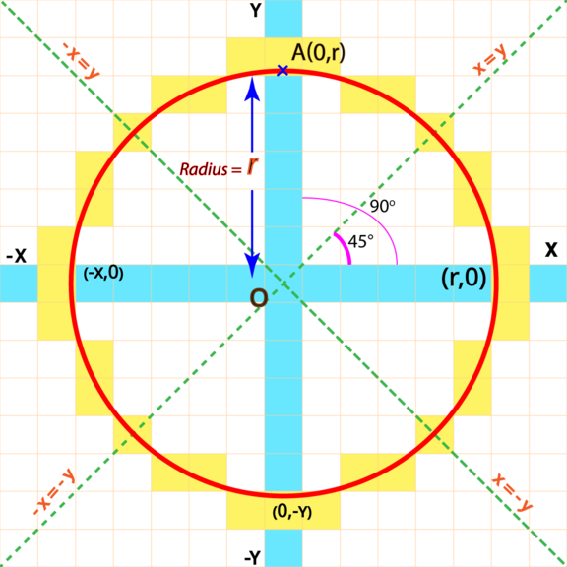
8 way symmetry
Radius = OA = r
Due to symmetrical property of Circle we don't need to calculate all the pixels of all the octets and quadrants
We need to find the pixels of only one octet, rest we can conclude through this.

Slide 4
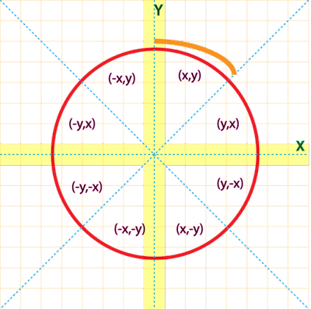
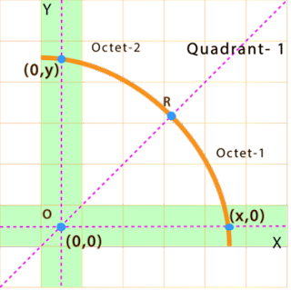
8 way symmetry
Lets take the Octet 2 which is in quadrant 1
here both x and y are positive where the initial pixel would be (0,y) coordinate
While(x>=y)
Putpixel(x,y,c);
Putpixel(y,x,c);
Putpixel(y,-x,c)
Putpixel(x,-y,c)
At point R both the value of both x and y coordinates would be same as R is at same distance of Both X and Y axis.

Slide 5
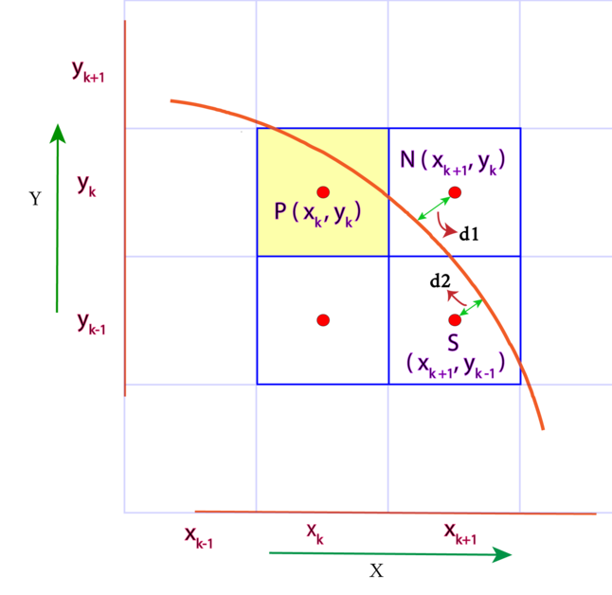
Derivation of Bresenham’s circle drawing algorithm

Slide 6
Derivation of Bresenham’s circle drawing algorithm
The shortest of d1 and d2 will help us Decide our next pixel.
note-
x_{k+1} = x_{k} +1
As x_{k+1} is the next consecutive pixel of x_{k}
similarly
y_{k-1} = y_{k} -1
Equation of Circle with Radius r
(x– h)² + (y – k)² = r²
When coordinates of centre are at Origin i.e., (h=0, k=0)
x² + y² = r² (Pythagoras theorem)

Slide 7
Derivation of Bresenham’s circle drawing algorithm
Function of Circle Equation
F(C) = x² + y² - r²
Function of Circle at N
F(N) = (x_{k+1})² + (y_{k})² – r² (Positive)
Here the value of F(N) will be positive because N is out-side the circle
that makes (x_{k+1})² + (y_{k})² Greater than r²
Function of Circle at S
F(S) = (x_{k+1})² + (y_{k-1})² – r² (Negative)

Slide 8
Derivation of Bresenham’s circle drawing algorithm
Here the value of F(S) will be Negative because S is in-side the circle that makes (x_{k+1})² + (y_{k-1})² Less than r²
Now we need a decision parameter which help us decide the next pixel
Say D_{k}
And , D_{k} = F(N)+F(S)
Here either we will get the positive or negative value of D_{k}
So if D_{k} < 0
that means the negative F(S) is bigger then the positive F(N), that implies Point N is closer to the circle than point S. So we will select pixel N as our next pixel.

Slide 9
Derivation of Bresenham’s circle drawing algorithm
and if D_{k} > 0
that means positive F(N) is bigger and S is more closer as F(S) is smaller. So we will Select S as our next pixel.
Now lets find D_{k}
D_{k} = (x_{k+1})² + (y_{k})² – r² + (x_{k+1})² + (y_{k-1})² – r²
(replacing x_{k+1} with x_{k} + 1 and y_{k-1} with y_{k} -1)
= (x_{k} + 1)² + (y_{k})² – r² + (x_{k} + 1)² + (y_{k} -1)² – r²
= 2(x_{k} + 1)² + (y_{k})² + (y_{k} -1)² – 2r² ----- (i)

Slide 10
Derivation of Bresenham’s circle drawing algorithm
Now lets find D_{k+1}
(Replacing every k with k+1)
D_{k+1} = 2(x_{k+1} + 1)² +(y_{k+1})² + (y_{k+1} -1)² – 2r²
= 2(x_{k+1} + 1)² + (y_{k+1})² + (y_{k+1} -1)² – 2r²
(Replacing x_{k+1} with x_{k} + 1 but now we can’t replace y_{k+1} because we don’t know the exact value of y_{k} )
= 2(x_{k}+1+ 1)² + (y_{k+1})² + (y_{k+1} -1)² – 2r²
= 2(x_{k}+2)² + (y_{k+1})² + (y_{k+1} -1)² – 2r² ----- (ii)

Slide 11
Derivation of Bresenham’s circle drawing algorithm
Now to find out the decision parameter of next pixel i.e. D_{k+1}
We need to find
D_{k+1} - D_{k} = (ii) - (i)
= 2(x_{k}+2)² + (y_{k+1})² + (y_{k+1} -1)² – 2r²
- [ 2(x_{k} + 1)² + (y_{k})² + (y_{k} -1)² – 2r²]
= 2(x_{k})² + 8x_{k} + 8 + (y_{k+1})² + (y_{k+1})² - 2y_{k+1} + 1 - 2r²
- 2x_{k} - 4x_{k} – 2 - (y_{k})² - (y_{k})² + 2y_{k} - 1 + 2r²
= 4x_{k} + 2(y_{k+1})² - 2y_{k+1} - 2(y_{k})² ₊ 2y_{k} + 6
D_{k+1} = D_{k} + 4x_{k} + 2(y_{k+1})² - 2y_{k+1} - 2(y_{k})² ₊ 2y_{k} + 6 ----- (iii)

Slide 12
Derivation of Bresenham’s circle drawing algorithm
If (D_{k} < 0) then we will choose N point as discussed.
i.e. (x_{k+1}, y_{k})
that means our next x coordinate is x_{k+1} and next y coordinate is y_{k} i.e. y_{k+1} = y_{k,} putting y_{k} in (iii) in replace of y_{k+1}
now,
D_{k+1} = D_{k} + 4x_{k} + 2(y_{k})² - 2y_{k} - 2(y_{k})² ₊ 2y_{k} + 6
= D_{k} + 4x_{k} + 6
If (D_{k} > 0) then we will choose S point.
i.e. (x_{k+1}, y_{k-1})
that means our next x coordinate is x_{k+1} and next y coordinate is y_{k} i.e. y_{k+1} = y_{k-1} putting y_{k-1} in (iii) in replace of y_{k+1}
now,
D_{k+1} = D_{k} + 4x_{k} + 2(y_{k-1})² - 2y_{k-1} - 2(y_{k})² ₊ 2y_{k} + 6

Slide 13
Derivation of Bresenham’s circle drawing algorithm
Now we know
y_{k-1} = y_{k} – 1
therefore,
D_{k+1} = D_{k} + 4x_{k} + 2(y_{k} -1)² - 2(y_{k} -1) - 2(y_{k})² + 2y_{k} + 6
= D_{k} + 4x_{k} + 2(y_{k}) ² + 2 - 4y_{k} - 2y_{k} +2 - 2(y_{k})² + 2y_{k} + 6
= D_{k} + 4x_{k} - 4y_{k} + 10
= D_{k} + 4(x_{k} - y_{k}) + 10

Slide 14
Derivation of Bresenham’s circle drawing algorithm
Now to find initial decision parameter means starting point that is (0,r) ,value of y is r
Putting (0,r) in (i)
D_{k} = 2(x_{k} + 1)² + (y_{k})² + (y_{k} -1)² – 2r²
D₀ = 2(0 + 1)² + r² + (r -1)² – 2r²
= 2 + r² +r² + 1 – 2r – 2r²
= 3-2r

Slide 15
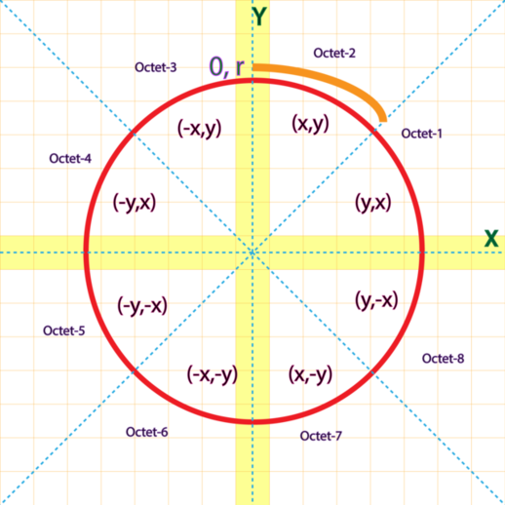
Derivation of Bresenham’s circle drawing algorithm

Slide 16
Derivation of Bresenham’s circle drawing algorithm
find pixels assuming that Centre is at Origin (0,0) then we will add the coordinates of centre to corresponding X and Y while drawing circle on screen.
Circle (Xc,Yc,X,Y)
{
Plot (Y+Xc , X+Yc) ……Octet-1
Plot (X+Xc , Y+Yc) ……Octet-2
Plot (-X+Xc , Y+Yc) ……Octet-3
Plot (-Y+Xc , X+Yc) …..Octet-4
Plot (-Y+Xc , -X+Yc) ……Octet-5
Plot (-X+Xc , -Y+Yc) ……Octet-6
Plot (X+Xc , -Y+Yc) ……Octet-7
Plot (Y+Xc , -X+Yc) ……Octet-8
}

Slide 17
Bresenham’s circle drawing algorithm
Step 1: Get the Radius of Circle R
And Coordinates of centre of circle (Xc,Yc).
Step 2: X and Y are going to be plotted points
Set X=0 and Y=R
Step 3: P = 3-2R (Initial decision Parameter)
Step 4: Plot Circle (Xc,Yc,X,Y)
Step 5: if P < 0 Then
P = P + 4X + 6
X=X+1
Y=Y
Else
P=P+4(X-Y)+10
X=X+1
Y=Y-1
Step 6: Check, if X=Y
Goto Step 7
Else
Goto Step 4
Step 7: Stop/Exit.

Slide 18
Example of Bresenham’s circle drawing algorithm
The radius of a circle is 8, and center point coordinates are (0, 0). Apply bresenham’s circle drawing algorithm to plot all points of the circle.
Solution:
Step 1: The given stating points of the circle (x_{1,} y₁) = (0, 0)
Radius of the circle (r) = 8
Step 2: Now, we will assign the starting point (x_{1,} y₁) as follows-
x₁ = 0
y₁ = r (radius) = 8
Step 3: Now, we will calculate the initial decision parameter (d₀)
P₀ = 3 – 2 x r
P₀ = 3 – 2 x 8
P₀ = -13
Step 4: The value of initial parameter P₀ < 0.
So, case 1 is satisfied.
Thus,
x_{k+1} =x_{k} + 1 = 0 + 1 = 1
y_{k+1} =y_{k} = 8
P_{k+1} = P_{k} + 4x_{k+1} + 6 = –13 + (4 x 1) + 6 = –3
Step 5: The center coordinates are already (0, 0) so we will move to next step.
Step 6: Follow step 4 until we get x >= y.

Slide 19
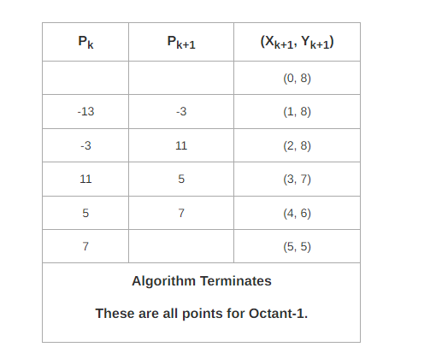
Example of Bresenham’s circle drawing algorithm
k | Pk | Pk+1 | (xk+1,yK+1)
 |  |  | (0,8)
0 | P0=3-2r =3-2*8 =3-16=-13 | P0<0 Yes Plot (xk+1,yk) P1=P0+ 4X + 6 = -13+4*1+6 =-3 | (1,8 ) x>=y
1 | P1=-3 | P1<0 Yes Plot (xk+1,yk) P2=P1+ 4X + 6 = -3+4*2+6 =11 | (2,8) x>=y
2 | P2=11 | P2<0 No Plot (xk+1,yk-1) P3=p2+4(X-Y)+10 =11+4(3-7)+10 =5 | (3,7) x>=y
3 | P3=5 | P3<0 No Plot (xk+1,yk-1) P4=p3+4(X-Y)+10 =5+4(4-6)+10 =7 | (4,6) x>=y
4 | P4=7 | P4<0 No Plot (xk+1,yk-1) | (5,5) x>=y yes stop

Slide 20
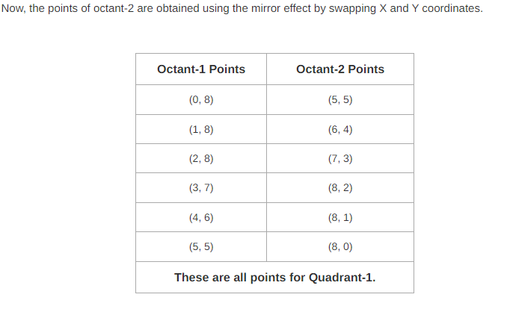
Example of Bresenham’s circle drawing algorithm

Slide 21
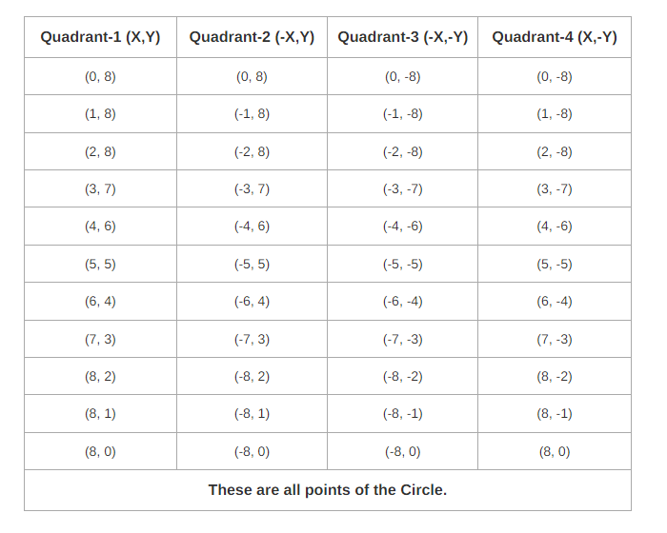
Example of Bresenham’s circle drawing algorithm

Slide 22
Given the centre point coordinates (10, 10) and radius as 10, generate all the points to form a circle.
Example of Bresenham’s circle drawing algorithm

